Slide 1


NACARSOFT · EXPLORADOR DE ADABAS
Your Adabas files,
in the browser. No client.
Browser
Tablet
Phone
desktop
iPad
iPhone
HTTPS · a single binary
NSAdaServer is the web explorer for Adabas files: see the records, create new files and run REST API queries, all from the browser and with the company's own access control.
NSAdaServer
Adabas web explorer
SEE FEATURES →
View files
Create files
REST API queries
table, form, JSON, DDM and ADAREP
ADAFDU from the browser
the same OpenAPI, with Execute
View files · Create files · REST API queries
Client connections to view, create and query through the API
browse · DDM · ADAREP · ADAFDU · OpenAPI

Slide 2
EL PROBLEMA
Looking at Adabas needs a desktop client
Every query is an input file, an ADABAS session and an export: nobody looks at the data when they need it, and the access stays outside the company's control.
01
Local installation
02
No access control
Every operator needs the ADABAS client installed, with its DDM and its credentials.
The file key travels with the person. There is no user, no role, no per-file permission.
03
No traceability
04
No API
What was queried, with which criteria and by whom is not recorded anywhere.
The data lives in a silo: the web, the ERP and the reports share nothing.
• Per-seat installs
• Keys per person
• Siloed data
Nacarsoft Soluciones Informáticas S.L. · nacarsoft.com · nsadaserver

Slide 3
QUÉ ES
The Adabas explorer, as a website
NSAdaServer is an Adabas file explorer in a single binary: the administrator declares the databases and their permissions, and users browse the files, see the records and work with them from any browser.
6
0
views per file
installations per desk
✓
Databases by name, with a connection pool and reconnection
✓
Files by DDM, with the field definition and its indexes
1
6
✓
Six views of the same file: table, form, JSON, DDM, ADAREP and API
binary, no dependencies
languages
✓
Creation of physical files with ADAFDU, without leaving the browser
Nacarsoft Soluciones Informáticas S.L. · nacarsoft.com · nsadaserver

Slide 4
ARQUITECTURA
How a record reaches the screen
1
2
3
4
5
Browser
Session and RBAC
Adabas pool
Record
Response
The request travels over HTTPS with the user session.
Cookie + JWT: user, group, roles and per-file permissions.
Connections with idle timeout and automatic reconnection.
The ISN, the fields and the descriptor, exactly as the DDM defines them.
Table, form or JSON, with pagination and search.
⚠ The local DDM leads: the field definition is cached on disk and does not depend on a live connection.
No local client
No DDM on the desk
The same rules for everyone
Nacarsoft Soluciones Informáticas S.L. · nacarsoft.com · nsadaserver

Slide 5
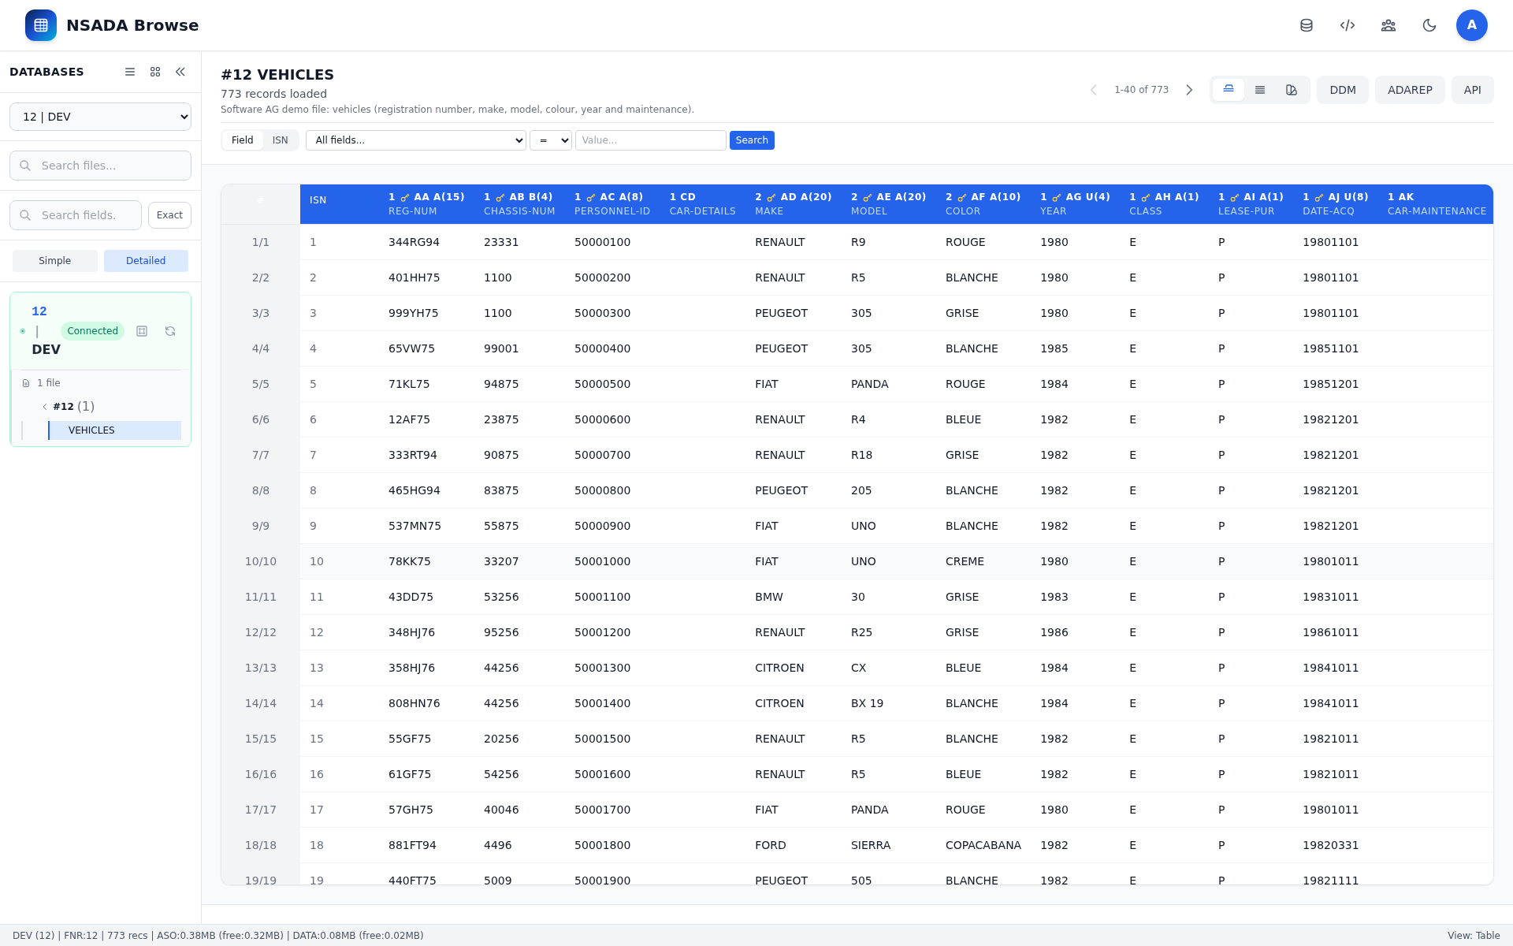
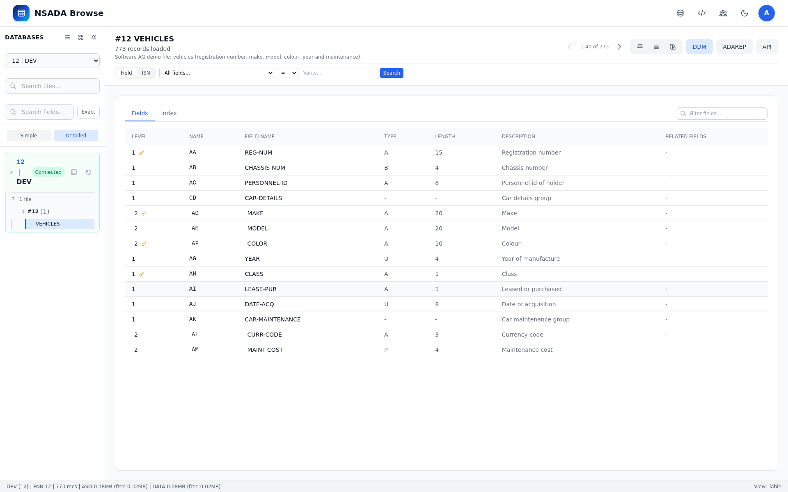
VER
Viewing files, in six views
Search by field or by ISN, with operators, sorting by descriptor and pagination.
Table
Form
JSON
DDM
ADAREP
API
The file as a grid, with the descriptor and the ISN of every record.
One record per form, with the DDM fields and their group elements.
The same information as JSON, ready to copy or integrate.
The full definition: level, type, length, description and indexes.
The real output of the server's ADAREP command.
The equivalent REST call, with its response and its cURL.
Nacarsoft Soluciones Informáticas S.L. · nacarsoft.com · nsadaserver

Slide 6
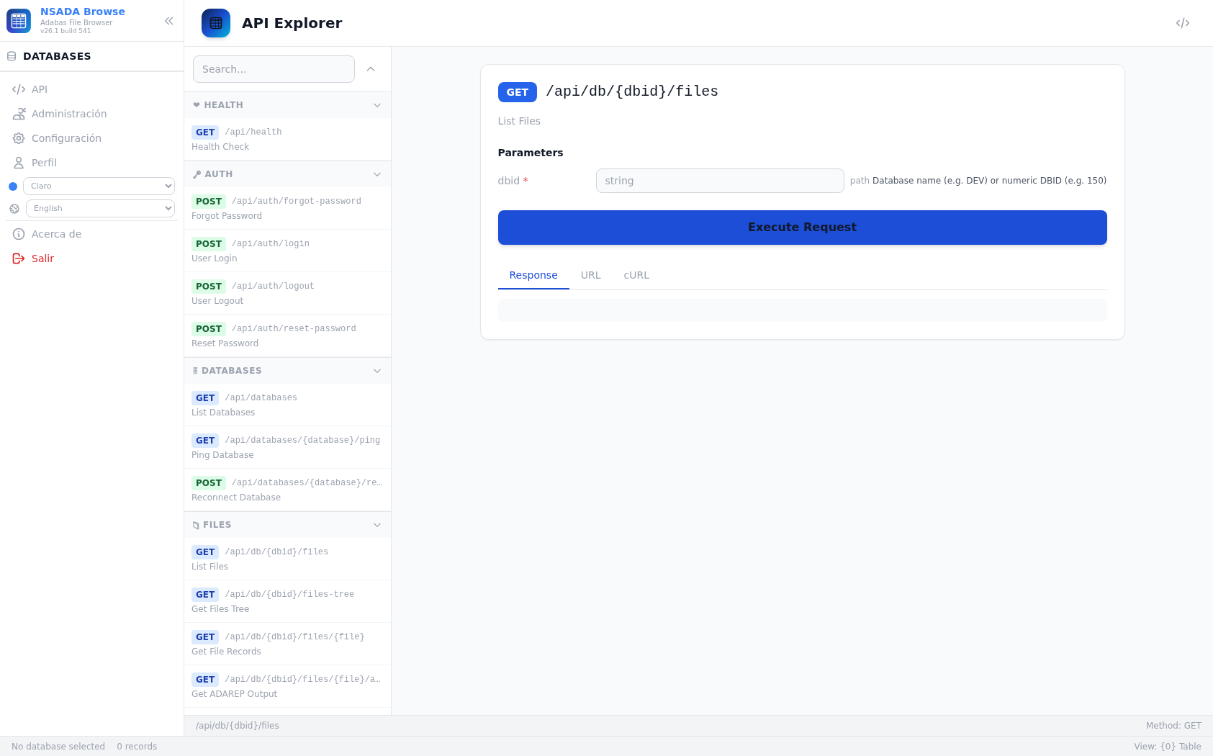
API-REST
REST API queries from the browser itself
The API explorer is a full REST console: the same endpoints the integrations consume, with parameters, body and response, without leaving the tool.
OpenAPI 3.0 served and explorable from the application itself
Endpoints grouped by domain: health, auth, databases, files, records and admin
Parameters, JSON body and Execute, with the response, the URL and the cURL
Authentication with the session token or with a scoped API key
The very same calls as the web, in a script: cURL ready to copy.
API Explorer: the endpoint, its parameters, Execute Request and the response.
Nacarsoft Soluciones Informáticas S.L. · nacarsoft.com · nsadaserver

Slide 7
CREAR
Creating physical files from the browser
ADAFDU
1
FNR and name
The file number and its logical name are chosen in the header.
Fichero físico creado
FNR
250
con su DDM, sus campos y sus permisos
Nombre
MI-FICHERO
2
Default values
Level, type, length and the NU, DE, UQ, PE, GR and MU flags.
✓ Fichero 250 en la base
Descripción
Clientes 2026
✓ DDM MI-FICHERO generado
3
Field table
Nivel/Tipo/Long
1 · A · 20
Each field with its level, name, type, length and description.
✓ Visible para quien tenga permiso
Campos
AA, AB, AC …
✓ Listo para escribir y leer
4
ADAFDU
NSAdaServer generates the physical file and its DDM on the server.
A new file, its DDM and its permissions, without hand-writing a DDM or requesting an input file.
Nacarsoft Soluciones Informáticas S.L. · nacarsoft.com · nsadaserver

Slide 8
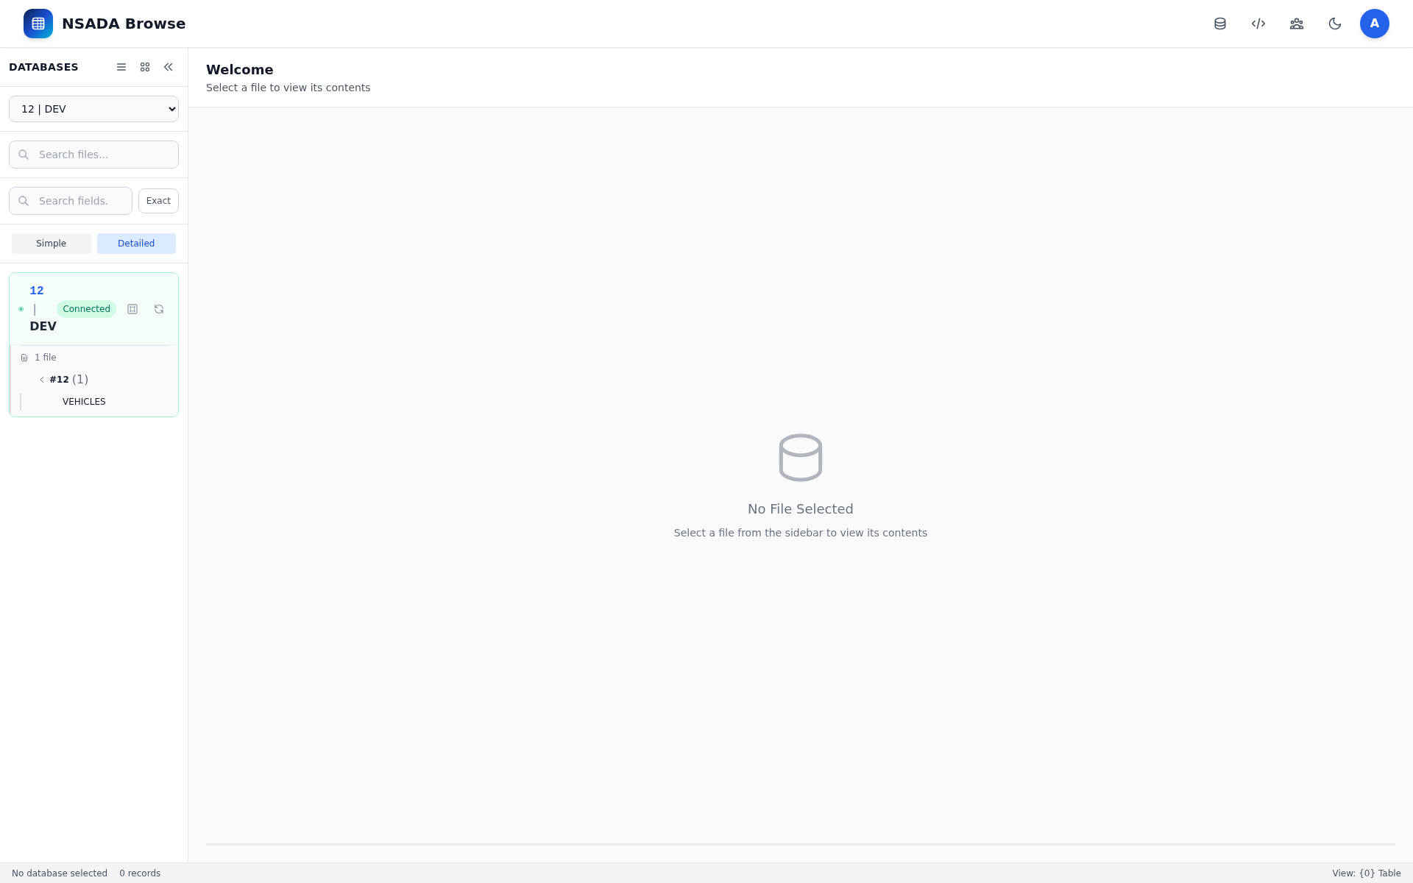
CONEXIONES
Databases declared in the configuration
Each database with name, DBID, connection string and configuration file
Several databases in the same instance, each with its own pool
Live state: connected, stopped for inactivity or in error
Reconnect, stop and ping from the panel itself
Each file's DDM is stored on disk: the list does not depend on the connection.
The database tree with its state and the files of each one.
Nacarsoft Soluciones Informáticas S.L. · nacarsoft.com · nsadaserver

Slide 9
PERMISOS
Permissions per file, not per person
Users → groups → roles → permissions per file
Read, write and delete per file, with a wildcard
File listings and records are filtered by permissions
API keys with scopes per integration, with revocation and audit
Access control
API keys
RBAC by roles and groups
Permission per file (read/write/delete)
Listings filtered by permissions
Access by token or API key
Scope per integration
Configurable expiry
Revoke and reactivate
Usage audit
Session
HS256 JWT in a cookie
Passwords with bcrypt
Recovery by email with a code
Lockout after failed attempts
config.yaml 0600 · bcrypt · JWT HS256 · per-operation audit · 30-day trial
Nacarsoft Soluciones Informáticas S.L. · nacarsoft.com · nsadaserver

Slide 10
OPERACIÓN
What you can do with a file
Read
Update
Delete
Records by pagination, with search by field, by ISN and by range.
Update a record by ISN, with its audit trail.
Delete by ISN, one or many, with a record.
Empty
Create
Drop
Empty a whole file, with the matching permission.
A new physical file with ADAFDU, with its fields and its DDM.
Remove the physical file and its definition from the DDM.
Todo lo que se hace con un dato queda registrado: acción, usuario y resultado.
Nacarsoft Soluciones Informáticas S.L. · nacarsoft.com · nsadaserver

Slide 11
GETTING STARTED
From zero to queryable files, in three steps
1
Create the environment
REQUIREMENTS
nsadaserver init /opt/nsadaserver: it creates config.yaml, the SQLite user database, the logs and the admin user.
Linux (RHEL 8 / RHEL 9)
Native Adabas client (CGO)
A single binary, no dependencies
Reverse proxy with HTTPS in production
Web panel on port 11010
2
Declare the databases
In config.yaml: name, DBID, connection string and the DDM file of each database.
3
Register the users
Administration → Users and groups: each user only sees the files their role allows.
nsadaserver init /opt/nsadaserver → nsadaserver start /opt/nsadaserver → http://localhost:11010
Nacarsoft Soluciones Informáticas S.L. · nacarsoft.com · nsadaserver

Slide 12
FREQUENTLY ASKED
The questions we hear most
Is the Adabas client needed?
Can the data be queried through an API?
Only on the server, and optionally: the DDM is stored on disk, so the file list and its definition are shown without a live connection.
Yes: the REST API with OpenAPI 3.0 is published, explorable from the panel itself and consumable with a token or scoped API keys.
Can new files be created?
Who sees which file?
Yes: from the browser, with the ADAFDU form: FNR, name, default values and the field table. The DDM is generated too.
The permission lives on the role, per file, with read, write and delete. Listings and records are filtered with those permissions.
Is what they do recorded?
Does the user need the DDM on their desk?
Yes: every operation is logged with its user and its result, and the API keys have their own usage log.
No: the DDM travels with the file definition and the browser shows it. The operator installs nothing.
Nacarsoft Soluciones Informáticas S.L. · nacarsoft.com · nsadaserver

Slide 13
Your company Adabas,
open in the browser
Try NSAdaServer with your databases: we set it up with your files and watch it run.
Guided demo
Try it in your environment
Let's talk about your case
nacarsoft.com · support@nacarsoft.com
Nacarsoft Soluciones Informáticas S.L. · nacarsoft.com · nsadaserver

