Slide 1


NACARSOFT · CONNECTION GATEWAY
One single entry point
to your whole environment.
Browser
Tablet
Phone
desktop
iPad
iPhone
HTTPS · WSS · RBAC
NSGateway concentrates terminals, SSH servers, internal applications and public portals: a reverse proxy with login, RBAC and auditing in a single binary.
NSGateway
gateway + proxy
SEE FEATURES →
Servers and SSH
Apps and portals
>
web terminal and SSH with no client
reverse proxy with login and audit
HTTPS · RBAC · Auditing · No clients
one entry point for your whole environment
sessions · apps · groups · audit · proxy

Slide 2
EL PROBLEMA
Access to servers and consoles does not scale
Every operator carries their own client, keys and tunnels: sessions cannot be audited and internal consoles stay outside the access policy.
01
Keys per person
02
No central identity
A keyring nobody maintains. Rotation becomes a quarter-end project.
Everyone gets in as they can. No user, no role, no expiry.
03
No audit
04
Loose consoles
The SSH login leaves no useful trace: nobody knows what ran or from where.
The intranet is published on its own, bypassing the access policy.
• Scattered clients and keys
• No central identity
• Untraceable consoles
Nacarsoft Soluciones Informáticas S.L. · nacarsoft.com · nsgateway

Slide 3
QUÉ ES
The connection gateway for your environment
NSGateway brings the web terminal, SSH access, reverse proxy and public portals together in a single binary. The administrator publishes applications and targets; the user enters through one URL with their identity, RBAC and audit.
0
1
clients to install
binary, no dependencies
✓
xterm terminals with tabs, reconnection and Natural PF keys
✓
SSH applications with no client to install: host, port and authentication
HTTPS
4
✓
Reverse proxy for internal applications, with allowlist and SSRF protection
the only network need
access modes
✓
Public/private portals and Host-based sites: limits, logs and audit
Nacarsoft Soluciones Informáticas S.L. · nacarsoft.com · nsgateway

Slide 4
ARQUITECTURA
How a keystroke travels, step by step
1
2
3
4
5
Browser
Web session
Check
PTY on the host
Live output
xterm.js: key, mouse and scroll travel over WebSocket.
Cookie + JWT: the user is already authenticated and role-bound.
Group quota, active app and allowed target before opening.
The command starts with the assigned user and its environment.
The output returns to xterm and is recorded as a session.
⚠ The session lives on the server: if the browser closes, the process keeps running and can be picked up later.
HTTPS and WSS only
No shell on the client
Auditable session
Nacarsoft Soluciones Informáticas S.L. · nacarsoft.com · nsgateway

Slide 5
SIN SSH
No clients: HTTPS is enough
No sshd, no keys, no bastion, no tunnels. NSGateway concentrates access and speaks WebSocket over TLS; the user just opens a URL.
Access | SSH client + private key | Browser with a session cookie
Identity | The user's public key | Panel user, group and role
Audit | At best, auth.log | Log per session, user and IP
Quotas | None | Max sessions per user and group
Internal consoles | Tunnels and port forwarding | Reverse proxy with RBAC
For the user | Install and configure a client | Open a URL
The only network requirement is a reverse proxy with HTTPS on port 11030.
Nacarsoft Soluciones Informáticas S.L. · nacarsoft.com · nsgateway

Slide 6
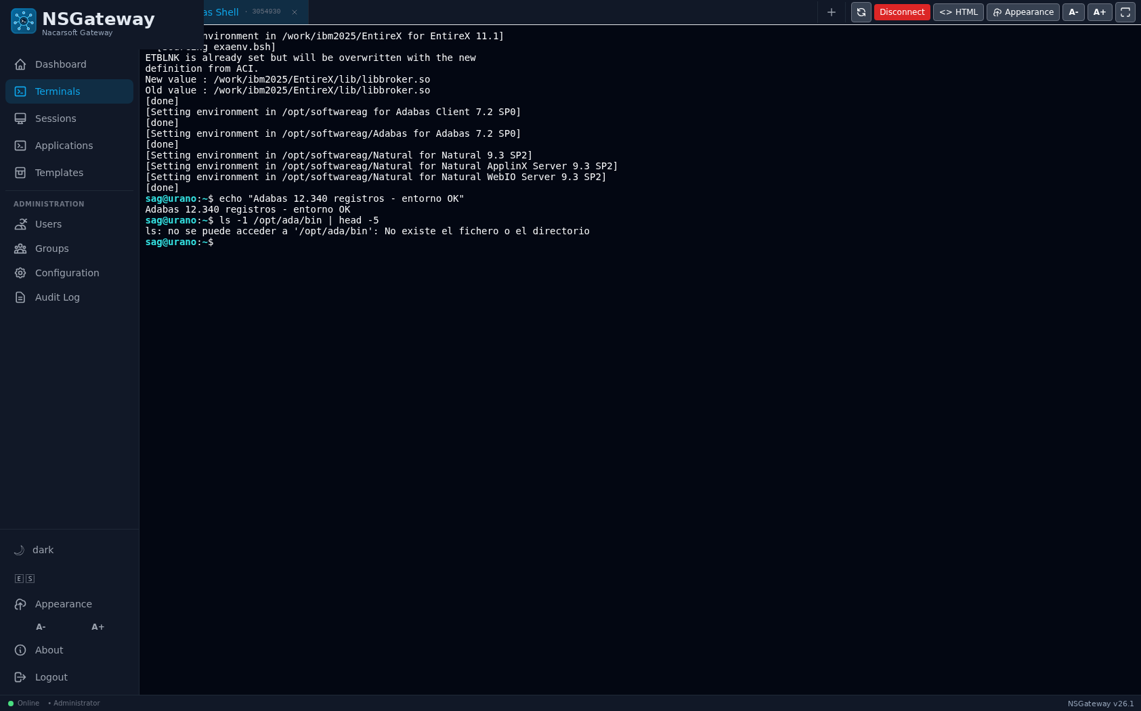
CONEXIONES
From the desktop browser
xterm.js with the server character set and colours
Tabs: several terminals at once, with name and PID
Reconnection: reload the page and the session is picked up
Full screen, font sizing and HTML mirror
Shortcuts and Natural function keys (PF) when the app asks for them
No plugin
No PuTTY Java
Bookmarks and favourites
A real terminal in the browser, with the session PID on the tab.
Nacarsoft Soluciones Informáticas S.L. · nacarsoft.com · nsgateway

Slide 7
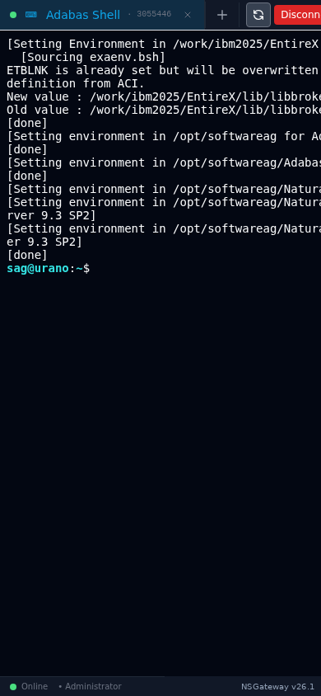
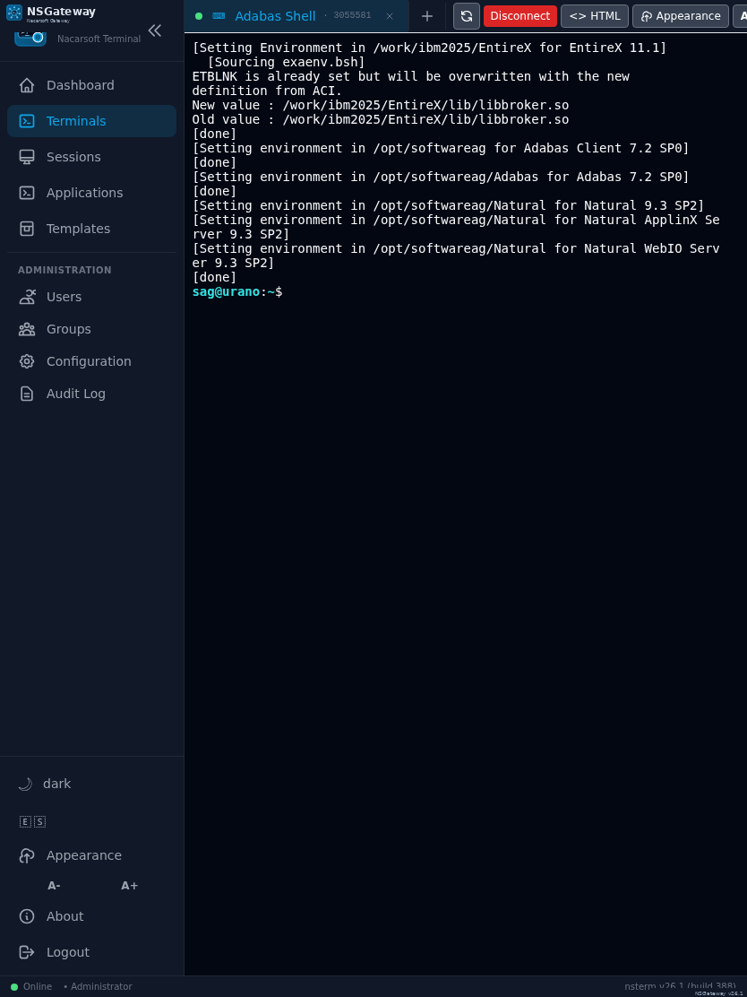
MÓVIL Y TABLETA
Also from the tablet and the phone
The same session, with the layout adapted to the screen width
On-screen keyboard with the keys the app needs
Long press and text selection over the command output
Ideal for one-off queries and on-call duty away from the desk
The very same link works on the PC, the tablet and the phone.
Tablet: 834 px, a comfortable working width.
Phone: 390 px, the terminal adapts without losing commands.
Nacarsoft Soluciones Informáticas S.L. · nacarsoft.com · nsgateway

Slide 8
PROXY INVERSO
Reverse proxy: publish your internal consoles
Beyond terminals, NSGateway publishes internal web applications: it exposes an http/https URL through NSGateway itself, inheriting the login, the per-group RBAC and the audit.
Browser
NSGateway
Internal app
https://term.company.local
login + RBAC + audit
https://intranet:8443/app
Only admin-defined URLs: the user never types one
Host allowlist, private-IP and cloud-metadata blocking
Link rewriting and WebSocket support on the backend
Per-application body limit and response timeout
The internal console leaves the network and goes through the very same login as the terminal.
Nacarsoft Soluciones Informáticas S.L. · nacarsoft.com · nsgateway

Slide 9
PUBLIC SITES
One Host, its routes: Caddy-style inside NSGateway
Publish internal applications as independent sites by Host, without writing a Caddyfile: NSGateway routes by Host and path, compresses, redirects and logs every request.
Host
Route
Upstream
erp.company.local
/api/* → app erp-api
http://10.0.0.20:8080
Exact or wildcard Host (*.company.local); routes /api/*, /health or /*
Proxy to an existing app or redirect 301/302/307/308
strip_prefix, preserve_host and request/response headers
gzip/zstd and JSONL log per site or route
Read-only Caddyfile tab with the equivalent block
erp.company.local {
encode gzip zstd
/api/* → erp-api (strip)
/old → /new 301
}
No own TLS/ACME, static files, basic_auth or load balancing in this version.
Public sites: no login or RBAC; WAF, rate limit, blocklist and SSRF still apply. TLS terminates in front.
Nacarsoft Soluciones Informáticas S.L. · nacarsoft.com · nsgateway

Slide 10
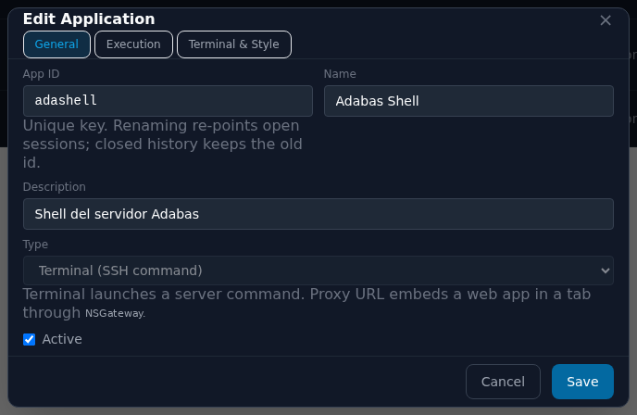
ADMINISTRACIÓN
Applications: the admin decides what is published
Command, arguments, working directory and environment
Terminal size (cols/rows) or fit to the container
Colour scheme, icon, logo and application colour
System user it runs as: fixed or the connected user's account
Session timeout, HTML design and Natural keys
A user only sees the applications assigned to their groups.
The application editor: id, name, description, type and state.
Nacarsoft Soluciones Informáticas S.L. · nacarsoft.com · nsgateway

Slide 11
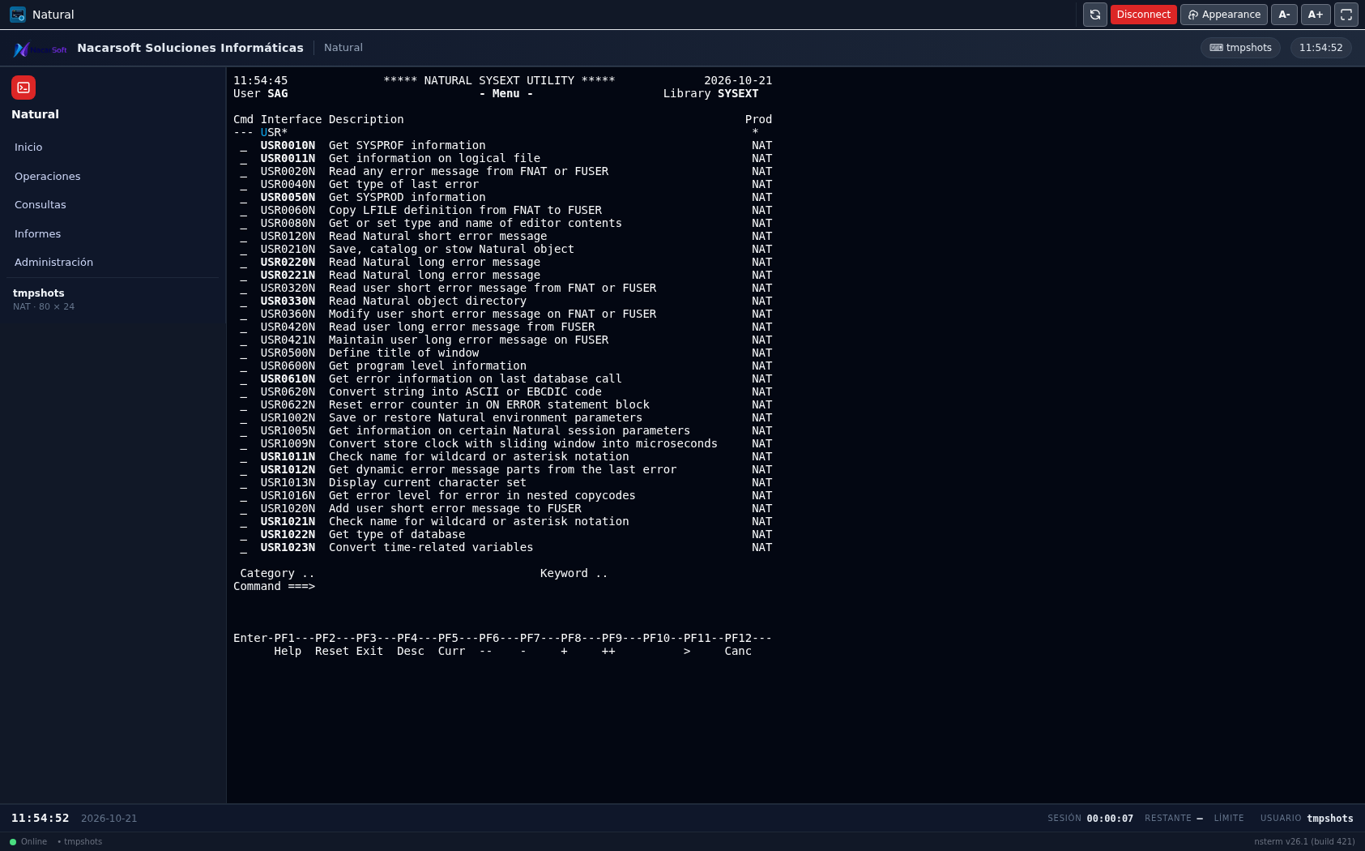
PLANTILLAS
Templates: the terminal with a web application look
Header, side containers and status bar with your own HTML and CSS
Corporate logo and name, taken from the server configuration
PF1..PF12 buttons that send the key to the session
Live values: clock, date, session time and remaining time
The CSS runs isolated: it cannot break the NSGateway interface
Eleven example templates are created on install: assign the one you want to each application.
The same application, with a corporate header, side menu and a status bar with the clock.
Nacarsoft Soluciones Informáticas S.L. · nacarsoft.com · nsgateway

Slide 12
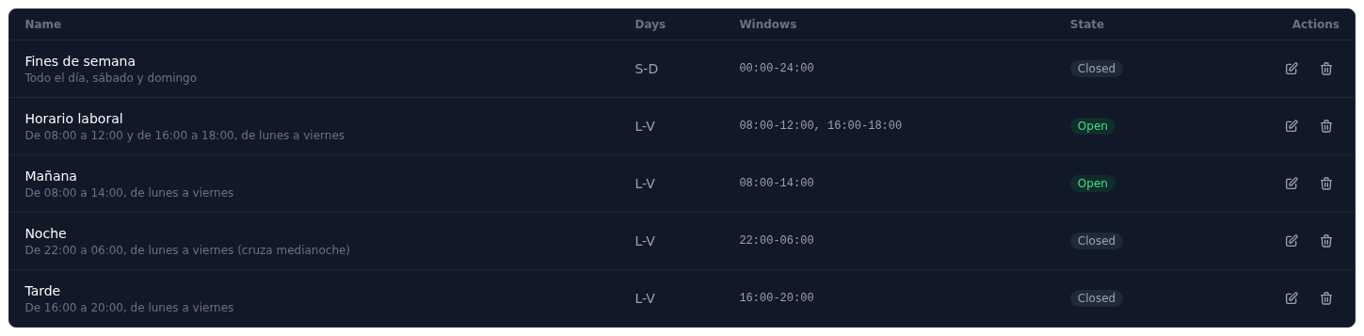
HORARIOS
Schedules: the application is only available in its window
Schedule templates: morning, afternoon, night, weekend
Outside the window the app shows as Closed on the dashboard
The server blocks it: it cannot be opened bypassing the panel
Window per day, several windows and night shifts
Administrators are subject to the schedule as well
The available schedule templates and their current state.
Console access becomes office hours, instead of always being open.
Nacarsoft Soluciones Informáticas S.L. · nacarsoft.com · nsgateway

Slide 13
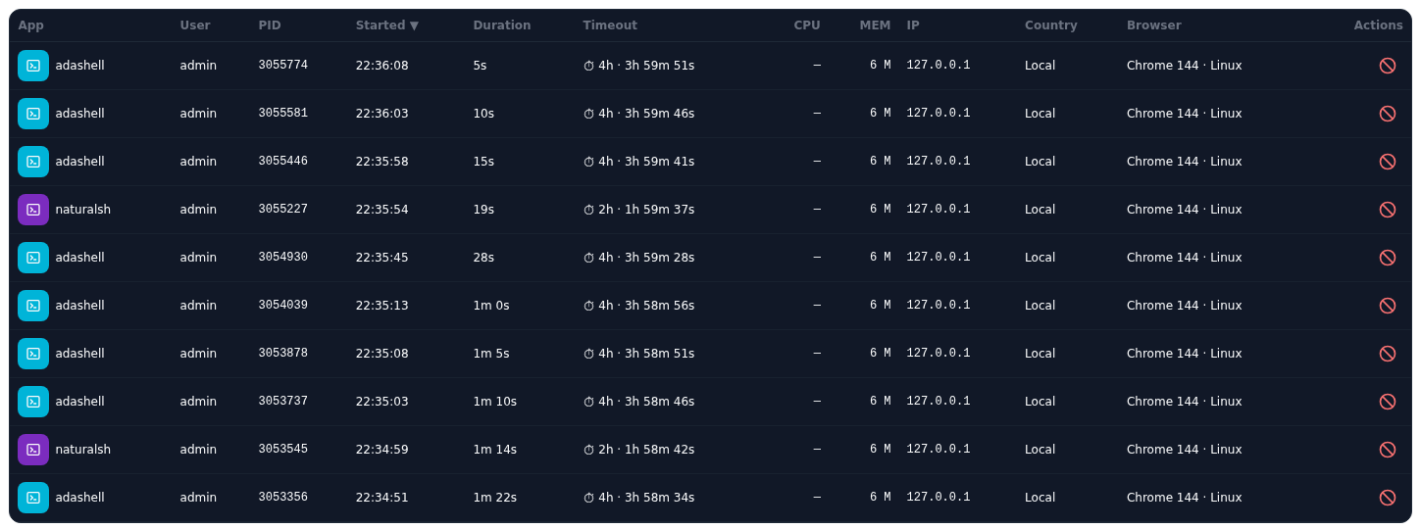
SESIONES
Every session is a process, and it is recorded
Application, user, PID, start and duration of every session
IP, country and browser of whoever opened it
Child processes: what the command has spawned
CPU, memory and the configured session timeout
Kill the session asking for a reason, which goes to the log
Sessions: who runs what, from where and since when.
The table updates live over WebSocket: no need to reload.
Nacarsoft Soluciones Informáticas S.L. · nacarsoft.com · nsgateway

Slide 14
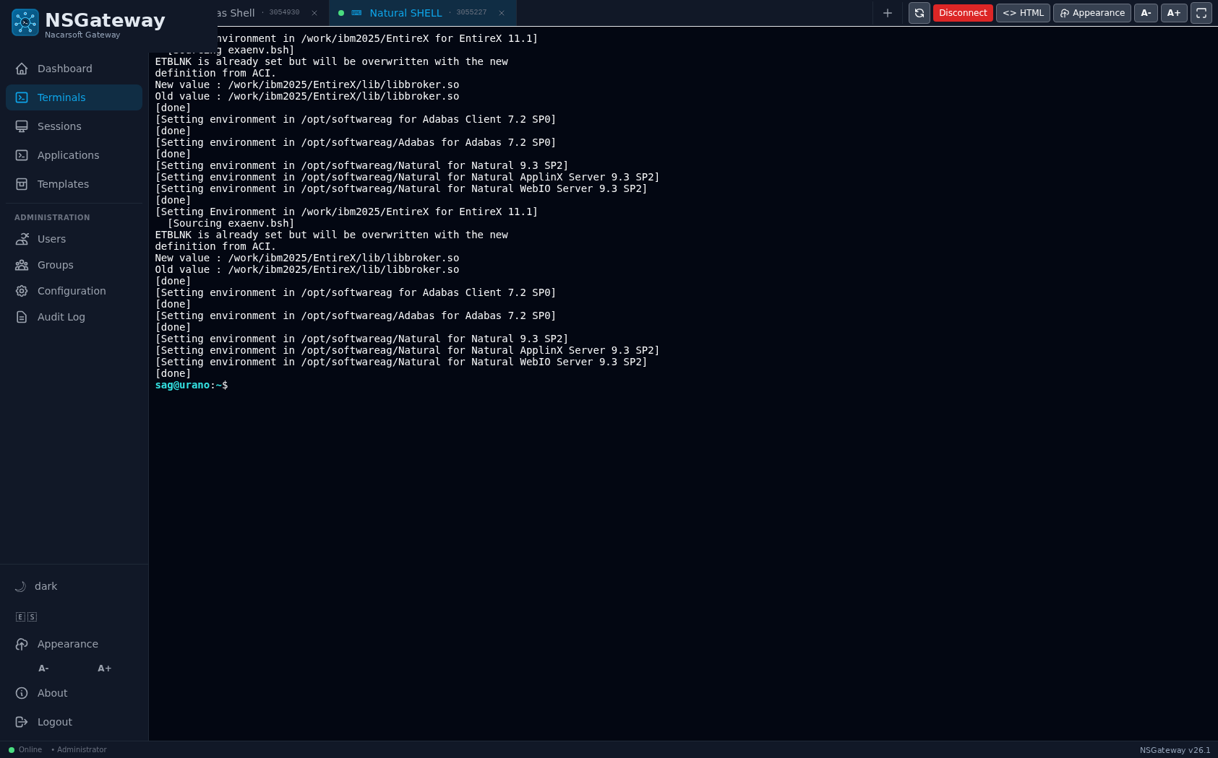
MULTITERMINAL
Several terminals, one window
A new tab without losing the previous session
Each tab with its own PID and application name
Automatic reconnection after a network drop
The session state, visible in the tab bar
Tabs: one terminal per session, all in the same window.
Nacarsoft Soluciones Informáticas S.L. · nacarsoft.com · nsgateway

Slide 15
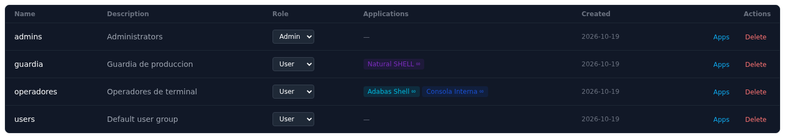
USUARIOS Y GRUPOS
Users, groups and session quotas
A user belongs to groups; the group defines the role
Each group has its applications assigned
Per-user, per-app quota: the group cap wins; 0 = unlimited
Past the quota, the terminal warns and opens no session
User administration: alias, email and state
Groups: role, assigned apps and the maximum sessions per user.
The same application can live in several groups, with different quotas.
Nacarsoft Soluciones Informáticas S.L. · nacarsoft.com · nsgateway

Slide 16
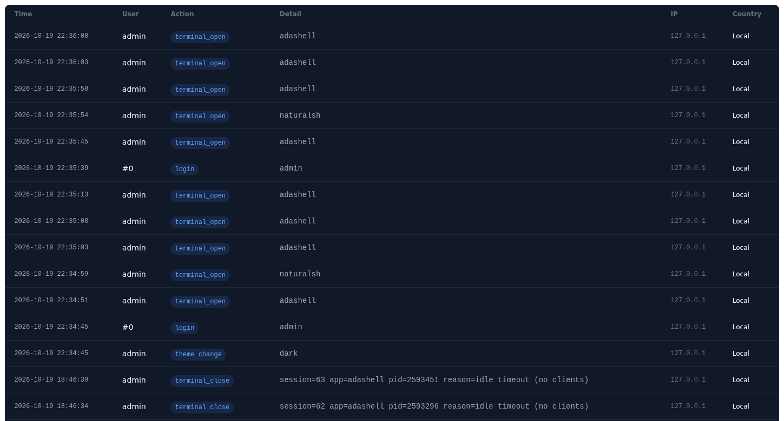
SEGURIDAD
Who opened what, and it is recorded
Logins, app creations, group changes and session endings
Mandatory reason when closing somebody else's session
Optional LDAP or Active Directory, alongside local users
Password policies: expiry, early warning and history
Session token with configurable expiry and HttpOnly cookie
Audit log: logins, applications, groups and session endings.
Machine-signed license and a 30-day trial.
Nacarsoft Soluciones Informáticas S.L. · nacarsoft.com · nsgateway

Slide 17
GETTING STARTED
From zero to a gateway, in three steps
1
Create the environment
REQUIREMENTS
nsgateway init /opt/nsgateway: it creates config.yaml, the SQLite database, the logs and the admin user.
Linux (RHEL 8 / 9)
A single binary, no dependencies
SQLite for state and audit
Reverse proxy with HTTPS in production
Port 11030 (configurable)
2
Publish the reverse proxy
Terminate TLS at the proxy and forward to https://server:11030. The server itself is not touched.
3
Publish the shell
Create the application (command, args, directory and environment) and assign it to the groups that need it.
No SSH: no need to open port 22, deploy keys or touch the sshd configuration.
nsgateway init /opt/nsgateway → nsgateway start --config /opt/nsgateway → https://term.company.local
Nacarsoft Soluciones Informáticas S.L. · nacarsoft.com · nsgateway

Slide 18
FREQUENTLY ASKED
The questions we hear most
Is it really true that no SSH is needed?
Who runs the command?
Yes. The browser talks HTTPS and WebSocket with NSGateway and the command runs on the server with its own PTY. sshd is not involved.
The admin decides: a fixed system user or the Linux account mapped to the connected user. NSGateway verifies the sudoers permissions.
Can I publish an internal website?
What if the browser closes?
Yes: a Proxy URL app for a single URL, or a site by Host (Caddy-style) with /api/* routes, redirects, compression and logs. Sites are public: WAF and limits still apply.
The session stays alive on the server. When you come back, the tab is restored and re-attached to the same process, with its PID.
How is usage limited?
Can it integrate with Active Directory?
Each group has a maximum of simultaneous sessions per user and application. Past it, the terminal warns and opens no new session.
Yes: LDAP/AD is optional and lives alongside local users. The user is mapped to their Linux account for the PTY.
Nacarsoft Soluciones Informáticas S.L. · nacarsoft.com · nsgateway

Slide 19
Your whole environment,
through one entry point
Try NSGateway with your environment: we set it up with your applications and watch it run.
Guided demo
Try it in your environment
Let's talk about your case
nacarsoft.com · support@nacarsoft.com
Nacarsoft Soluciones Informáticas S.L. · nacarsoft.com · nsgateway

